Slide 1
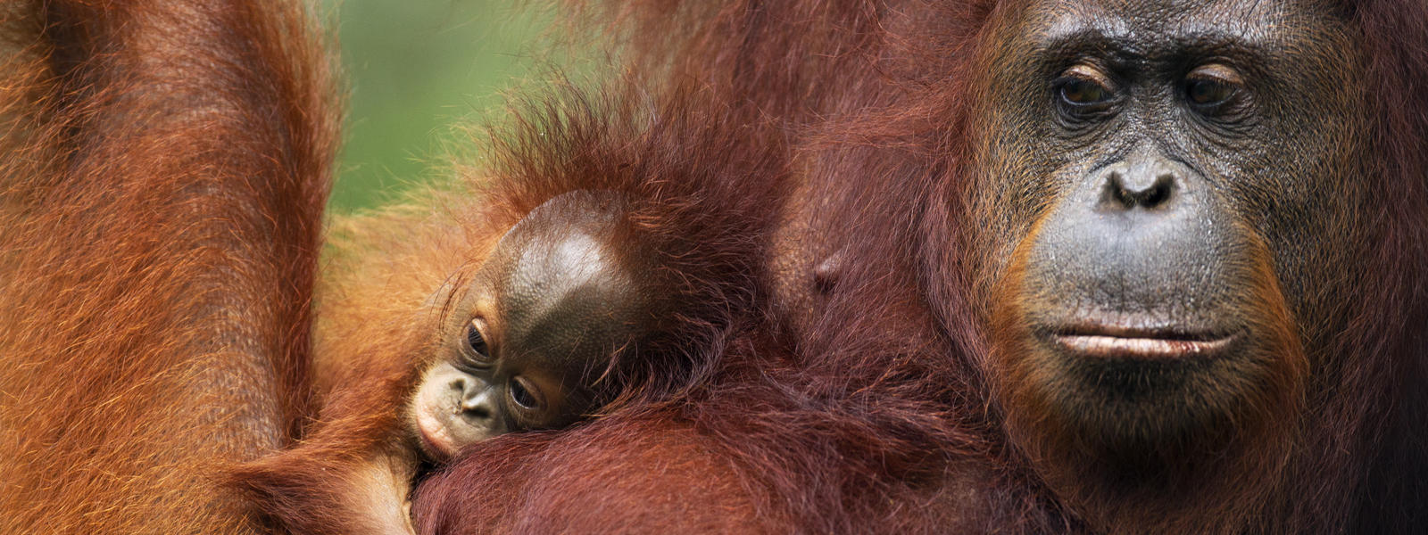
Orangutan Spatial Pattern
Liwen Zhang, Xuechun Liu, Kailun Huang

Slide 2

Project Background
Client: Andrea Blackburn, Anthropology Student
PhD Mentor: David Reynolds, Teaching fellow
Dataset: The orangutan point data was collected with handheld GPS units, and the spatial parameter data was extracted from landsat and DEM imagery using geographic information systems (GIS).
Dependent variables: Kernel Density Value for each point
Independent variables:
Normalized Difference Vegetation Index (NDVI), a measure of vegetation (-1 to 1)
The degree of the slope (0-90 degrees)
Elevation measured in meters
Euclidean Distance from point to the river (meters)
Research Question: How spatial parameters (altitude, slope, distance to river, and normalized difference vegetation index) predict an orangutan spatial point pattern
Notes:
NDVI： assess whether the target being observed contains live green vegetation or not

Slide 3
Geographically Weighted Regression
GWR is a spatial analysis technique that takes non-stationary variables into consideration and models the local relationships between these predictors and an outcome of interest.
Instead of assuming that a single model can be fitted to the entire study region, it looks for geographically differences.
Coefficients are allowed to vary.
Notes:
The shape and extent of the bandwidth is dependent on user input for the Kernel type, Bandwidth method, Distance, and Number of neighbors parameters with one restriction: when the number of neighboring features would exceed 1000, only the closest 1000 are incorporated into each local equation.
GWR should be applied to datasets with several hundred features for best results. It is not an appropriate method for small datasets. The tool does not work with multipoint data
(e.g., climate; demographic factors; physical environment characteristics)

Slide 4
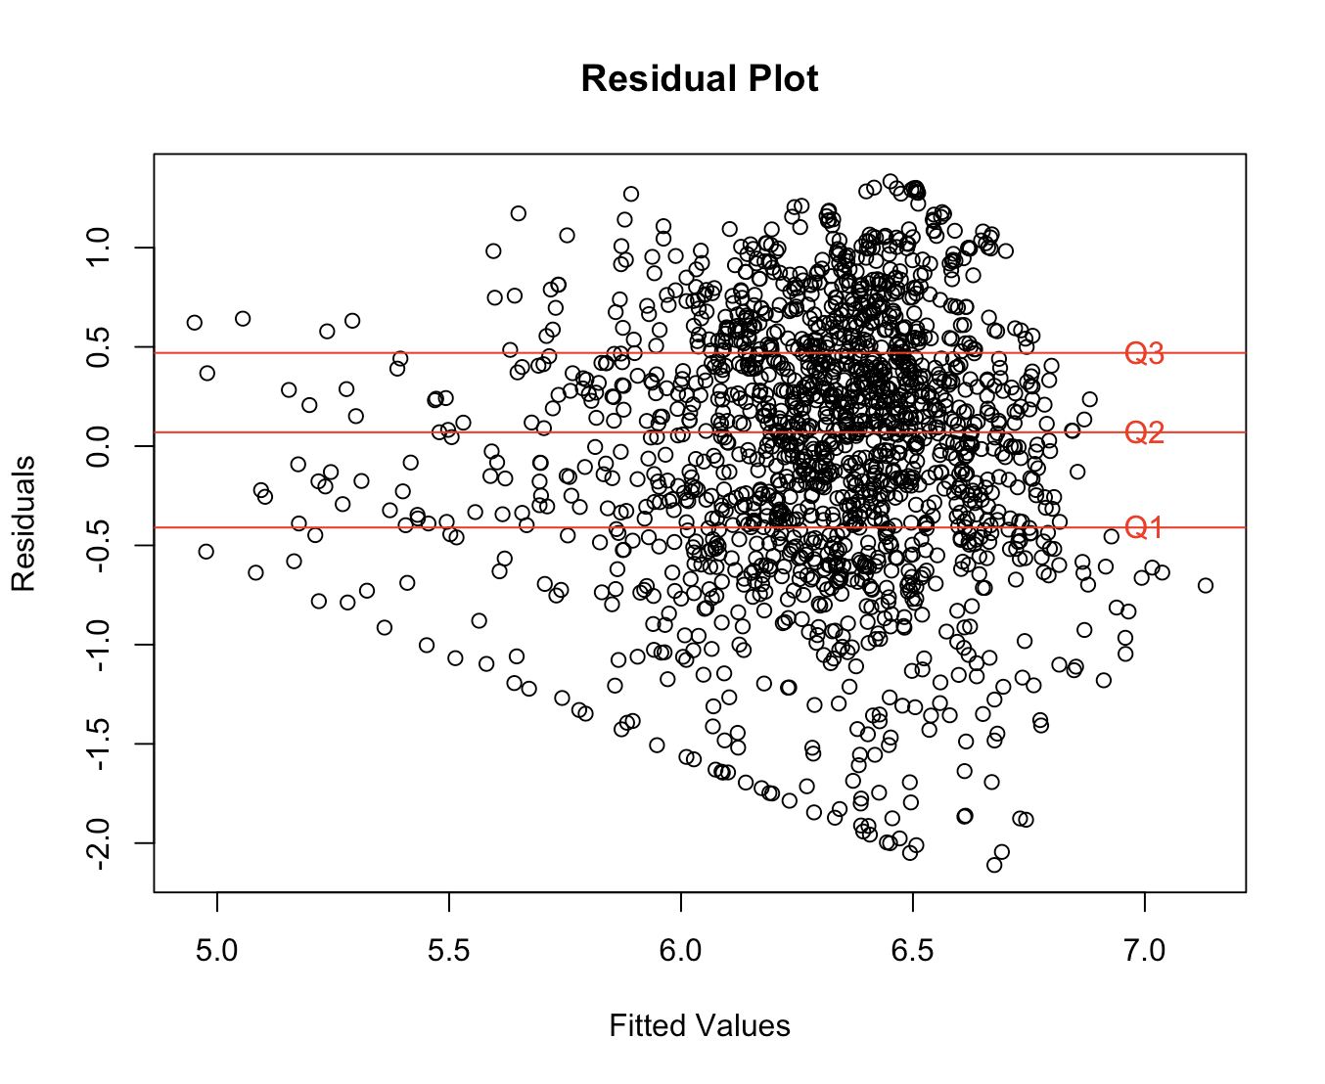
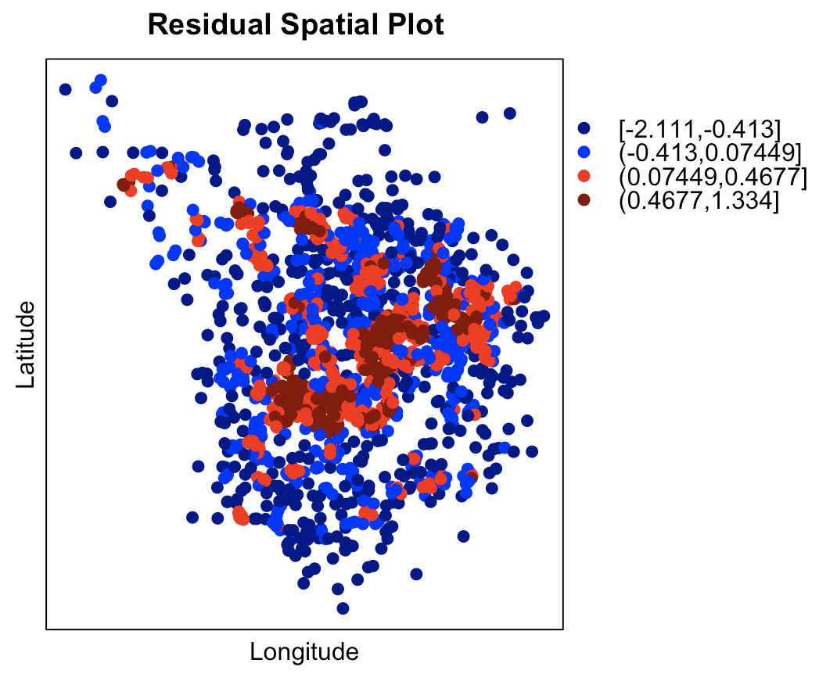
Spatial Pattern
lm(log(RASTERVALU) ~ NDVI_v2 + slope1 + altitude + dist_riv_b)

Slide 5
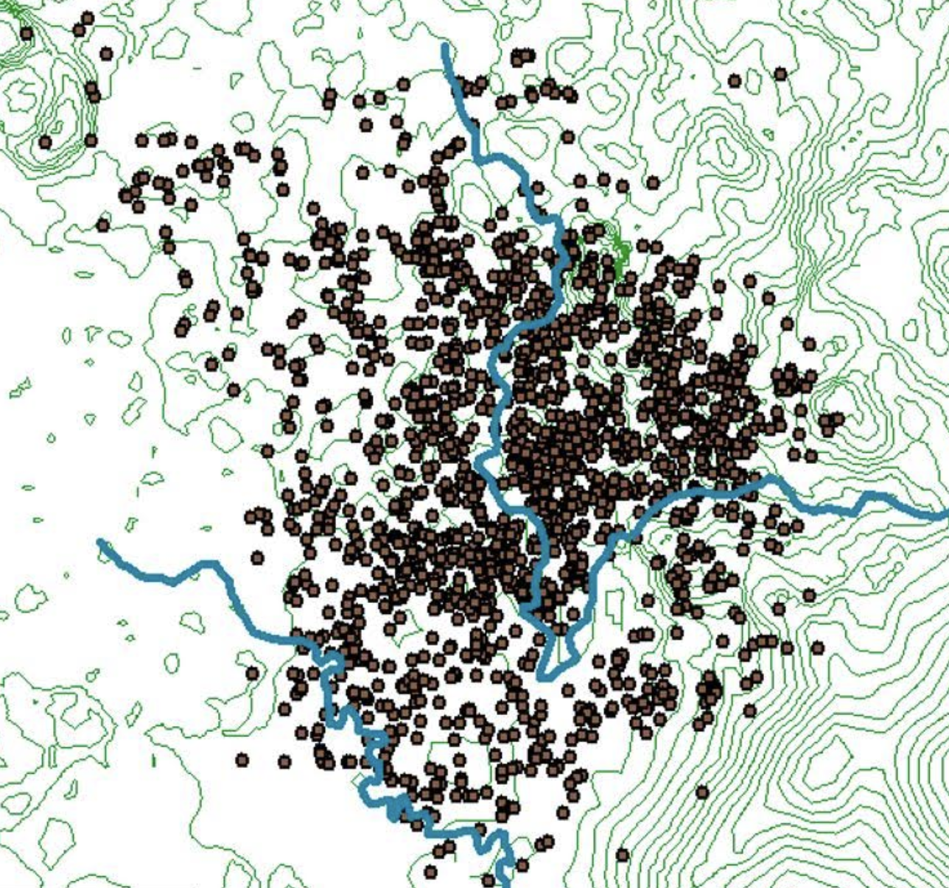
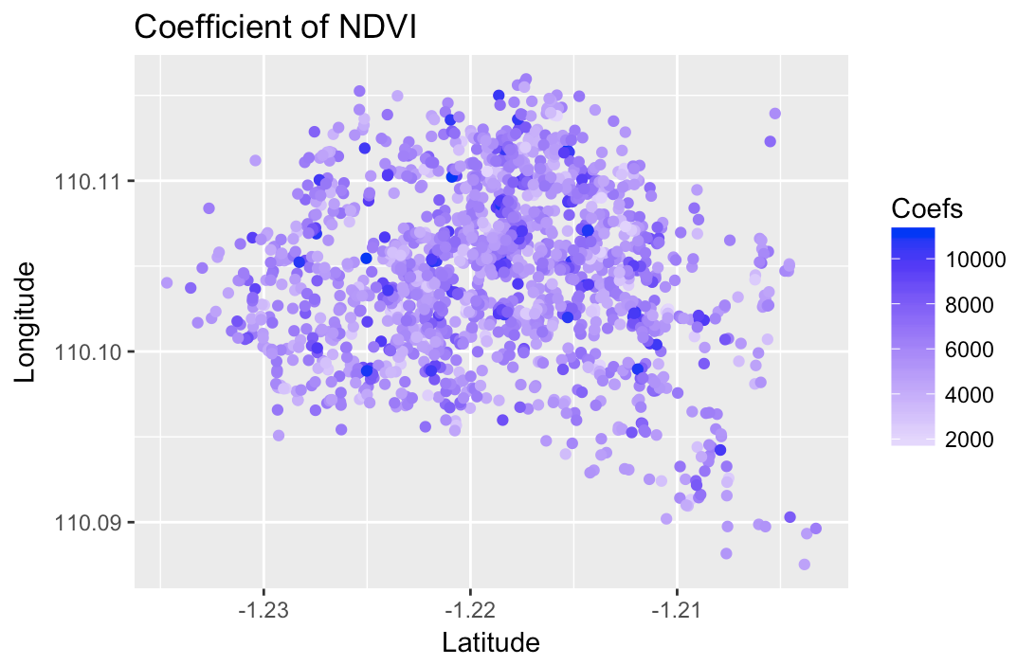
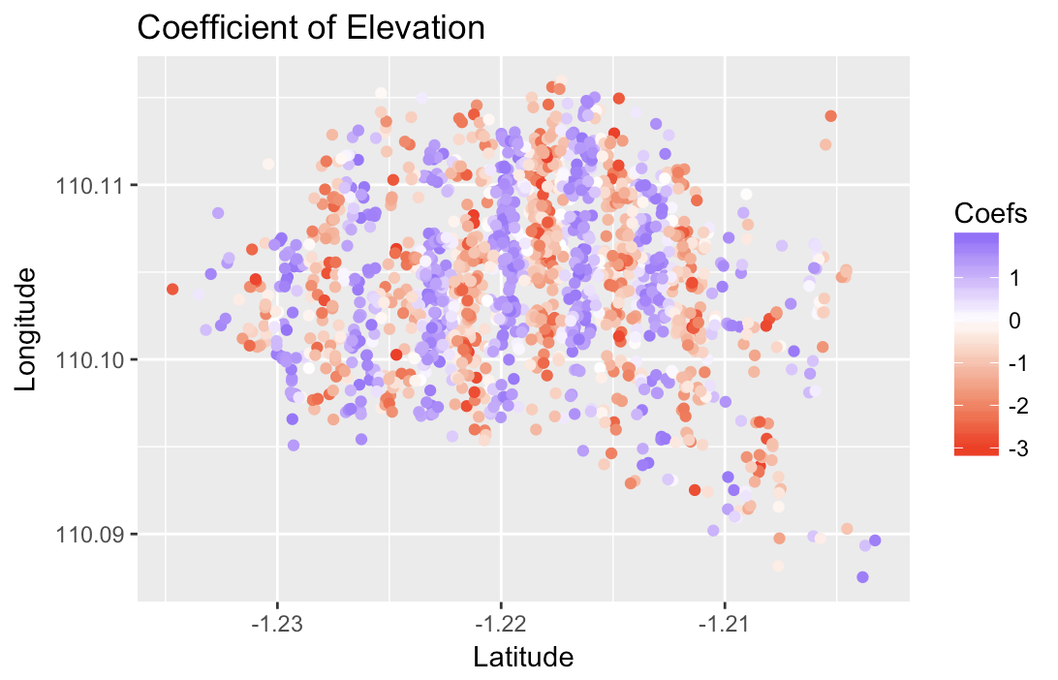
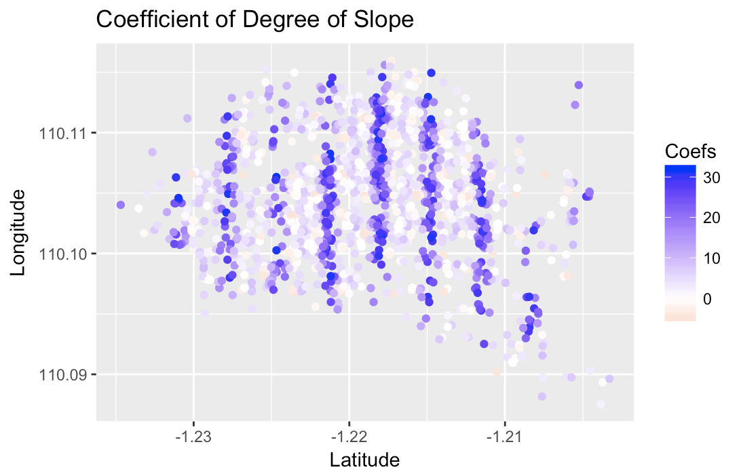
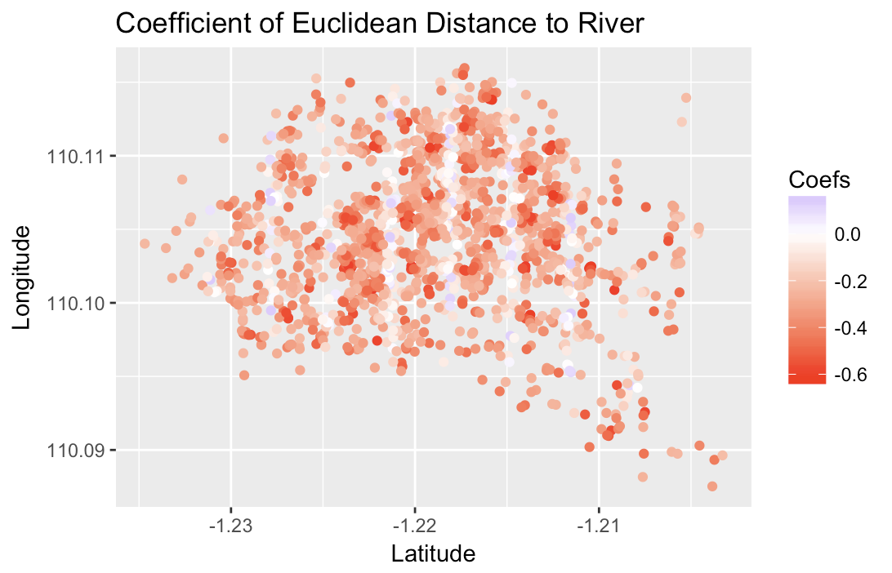
Coefficients for Different Variables

